Slide 1
Understanding KPI trade-offs
key challenges of modelling architectures and data acquisition
Gerald Gurtner, Andrew Cook
29 Sept. 2017
EASA, Cologne

Slide 2
Vista - goals and objectives
Vista aims to study the main forces (‘factors’) that will shape the future of ATM in Europe at the 2035 and 2050 horizons
More specifically:
  trade-off between, and impacts of, primary regulatory and business (market) forces;
  trade-offs within any given period;
  trade-offs between periods;
  whether alignment may be expected to improve or deteriorate as we move closer to Flightpath 2050’s timeframe
Focus on five stakeholders: airlines, ANSPs, airports, passengers, and environment.
2

Slide 3
Vista presentation
Evaluation – project engine is a simulation model^{WP4}
  extending award-winning, multi-layer model; leveraging new work
Market/business forces conflicting with regulation^{WP3}
  modelling change scenarios: collaborative design, with stakeholders
  exploring unintended consequences
    cheaper to cancel a flight? (Reg. 261)
    delay recovery v. emissions impact? (ETS; Directive 2008/101)
    ANSP delay levels driven too low? (SES PS; Reg. 549/2004)
Key stakeholders^{WP4}
  airlines; passengers / ANSPs / airports / environment
Impact metrics^{WP4}
  classical (e.g. average delay) & complexity (e.g. community detection)
  monetised (e.g. cost of delay) and quasi-cost (NO_{x}, σ²_{arr})
Trade-off analysis^{WP5}
  Pareto frontier; expected utility; Granger causality; precursor-successor analysis
3

Slide 4
Vista – How to produce a trade-off analysis
Trade-off: inverse relationship between two indicators. When one goes better, the other worsens.
Two types of trade-off:
Correlation with time series:
  Past time-series: usually not enough data for macro indicators
  Future time-series: need a model
Causal relationship: with a model.
What about a change in the system? How to compute the relationship between metrics in totally new environment?
4

Slide 5
How to produce quantitative knowledge for the future?
Data
Current
World
KPIs
Current situation
Quantitative Observation
DimensionalityReduction
Raw Data
5

Slide 6
How to produce quantitative knowledge for the future?
?
Data
Current
World
KPIs
Future
situation
6

Slide 7
How to produce quantitative knowledge for the future?
Data
Current
World
KPIs
Current situation
Dimensionalityreduction
Quantitative observation
Raw data
Correlation relationships
Machine learning domain
Extrapolation
Data
KPIs
Future situation
7

Slide 8
How to produce quantitative knowledge for the future?
System modification
Current
World
Quantitative observation
Raw Data
Physical
modelisation
(Causal) laws between variables
Phenomelogic observation
Raw synthetic
data
Causal and Correlation relationships
Physical modelisation domain
Data
KPIs
Hypothetic situation
Dimensionalityreduction
8

Slide 9
Challenges in data acquisition in Vista
'Raw data':
Format (and sometimes content!) not consistent over time and over bodies providing them
Openness: rarely open, usually expensive, or simply hard to get with very convoluted rules.
Quality: individual projects redoing over and over the same quality checks on the same datasets.
As many procedure to acquire data as number of datasets (at least): financial for airports, financial for airlines, financial for ANSPs, schedules, flight plans, real trajectories, itineraries, fares, etc.
'Phenomenological laws':
Coming directly from theory and or other machine learning studies.
Assumptions sometimes not clear, validity subject to other checks on the system
Can be completely wrong, whereas raw data can lie only where recorded wrong!

Slide 10
Scenario definition in Vista
Vista is a 'what-if' scenario analyser. Answer to:
What happens if I do this in the system?
And not:
What will happen in 2035?
==> Scenario definition, where different external factors can influence the system. Aim is not to compute the likelihood of a given scenario.
Factors are subdivided into two main categories:
Business factors: cost of commodities, services and technologies, volume of traffic, etc. => demand and supply
Regulatory factors: from EC or other bodies, e.g. ICAO, => ‘rules of the game’
Use in particular the different targets and high level views of SESAR to have a idea of the possible values of the parameters.

Slide 11
Scenario definition in Vista
Regulatory factors
Regulations affecting gate-to-gate phase
  SESAR development and integration (RSI): e.g., SES, Common projects.
  Performance based regulations (RPB): e.g, Performance review body
  ANSP requirements (RAR): e.g., Common requirements
Regulations affecting airports
  Airport demand (RAD): e.g., slots
  Airport processes (RAP): e.g., ground handling market
  Airport access / egress (RAA): e.g., airport access policies
Regulations affecting other areas
  Other regulations (ROR): e.g, passenger provision schemes, emission schemes
22 factors in total
Some of the regulatory factors are enablers of business factors

Slide 12
Scenario definition in Vista
Business factors
Factors affecting gate-to-gate phase
  SESAR operational changes (BTS): e.g., Free-routing
  Other operational and technical changes (BTO): e.g., Passenger reaccomodation tools
Airport processes and accessibility
  Airport access / egress (BAA): e.g., multimodality
  Airport processes (BAP): e.g., self-processing
Demand and other economic factors
  Demand evolution (BED): e.g., economic development
  Other economic factors (BEO): e.g., fuel price
37 factors in total

Slide 13
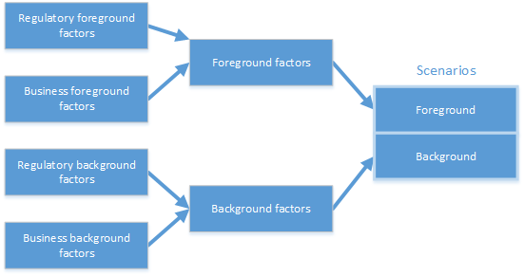
Scenario definition in Vista

Slide 14
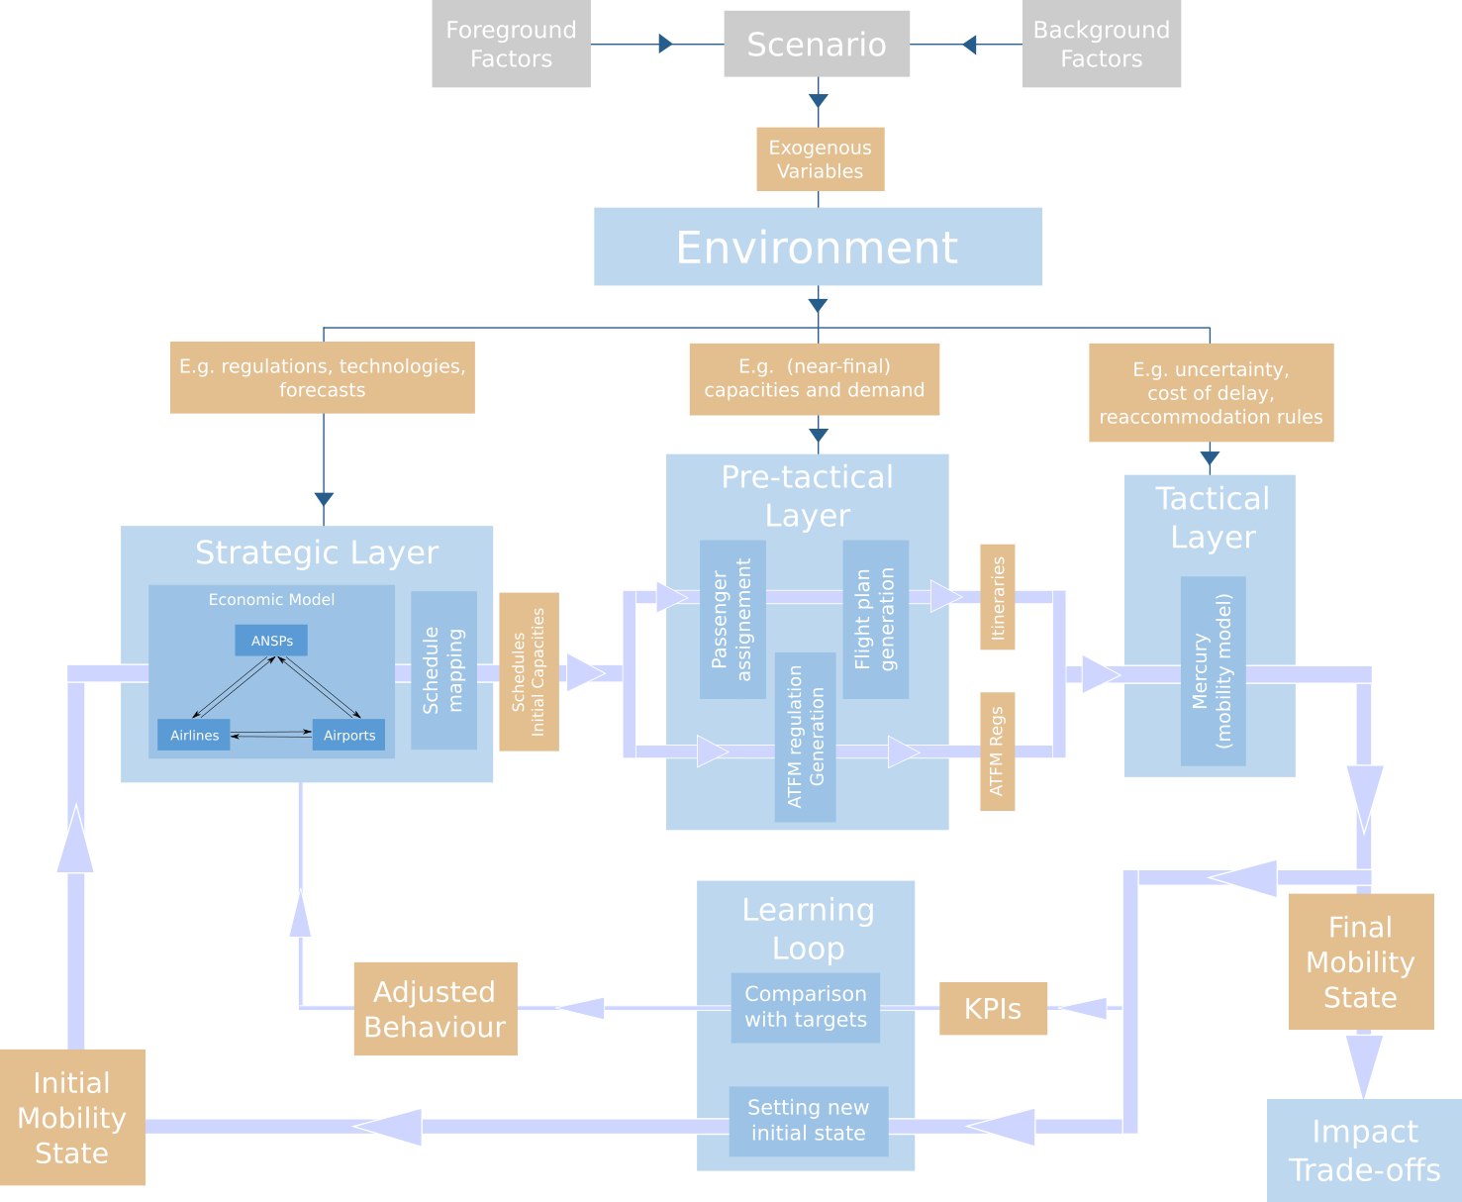
Multi-layered architecture of Vista

Slide 15
Multi-layered architecture of Vista
Factor 1
Val1
Val2
Val3
Val4
Model
Factor 2
Val1
Val2
Factor 3
Val1
Val2
Val3
Factor 4
Val1
Val2
Val3
Val4

Slide 16
Multi-layered architecture of Vista
  Three main layers correspond to:
  Strategic:
    Producing main flows in Europe based on macro-economic variables
  Pre-tactical:
    Producing planned flight plans.
  Tactical:
    Simulating a real day of operation with microscopic passenger tracking
'Transversal' layers consist in stakeholders:
Airlines: choose flights, react to delay, etc.
Airports: deliver departure and arrival capacity, create congestion, etc.
ANSPs: deliver ATC capacity, create regulations etc.
Passengers: choose best itineraries based on fares and other parameters, make their trips with possibility of disruption, etc.
Environment: is passively impacted by NOx and CO2.

Slide 17
Data management in a multi-layered architecture
Data need to be:
Consistent among layers,
Easily accessible (for computing power),
Traceable between the different blocks
==> All data are based on a single database, accessible to all the blocks. This ensures consistency, traceability and reproducibility.
More challenges come with this data architecture:
How to enforce consistency between input and output of two block?
How to take into account the multiple runs of the stochastic layers?
What is the right balance between flexibility (NoSQL) and consistency (SQL)?
==> Now use a MySQL database.

Slide 18
Calibrating the model
Calibration is done in several steps:
Direct calibration:
  Extract some values from historical data (including literature) and set them directly in the model:
    Ex: price elasticity for passengers
  Put some phenomenological relationships obtained otherwise:
    Ex: cost of delay for airline as a function of delay.
Indirect calibration:
  Supervised learning: a parameter is swept (in a smart way) in order for another one to reach a value extracted from data.
    Ex: cost of capital for airlines is calibrated to have the historical flows of passengers between airports.
  Unsupervised learning: for instance, agents in the model modify their behaviour in order to be self-consistent across layers.
    Ex: cost of delay used to compute main flows should be the same than actual cost of delay during the tactical phase.

Slide 19
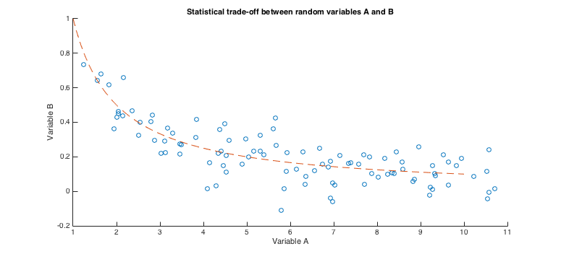
Studying the output: how to recognise a trade-off?
Stochastic context, correlative trade-offs

Slide 20
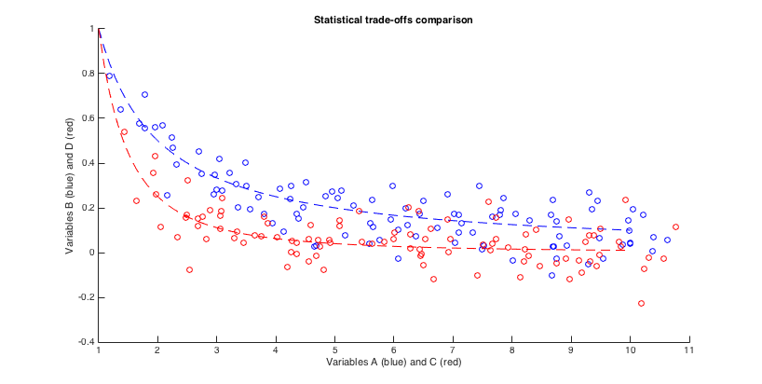
Studying the output: how to recognise a trade-off?
Stochastic context, trade-offs comparison

Slide 21
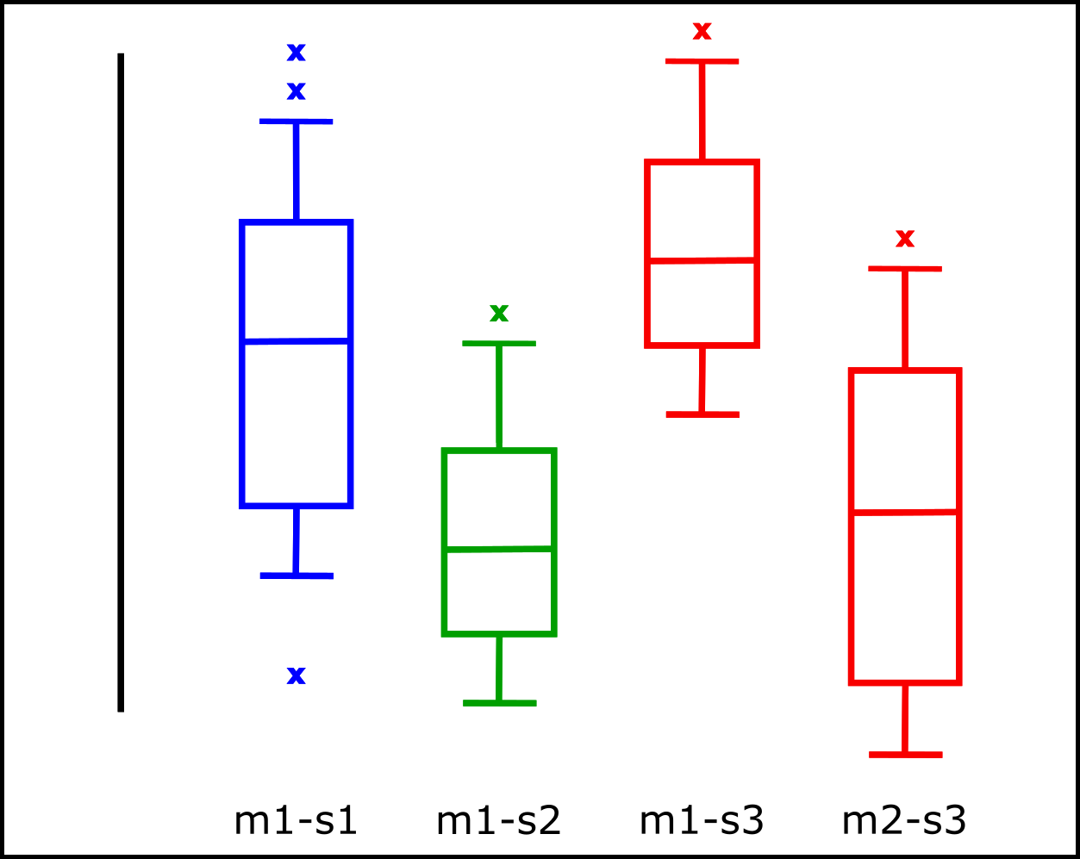
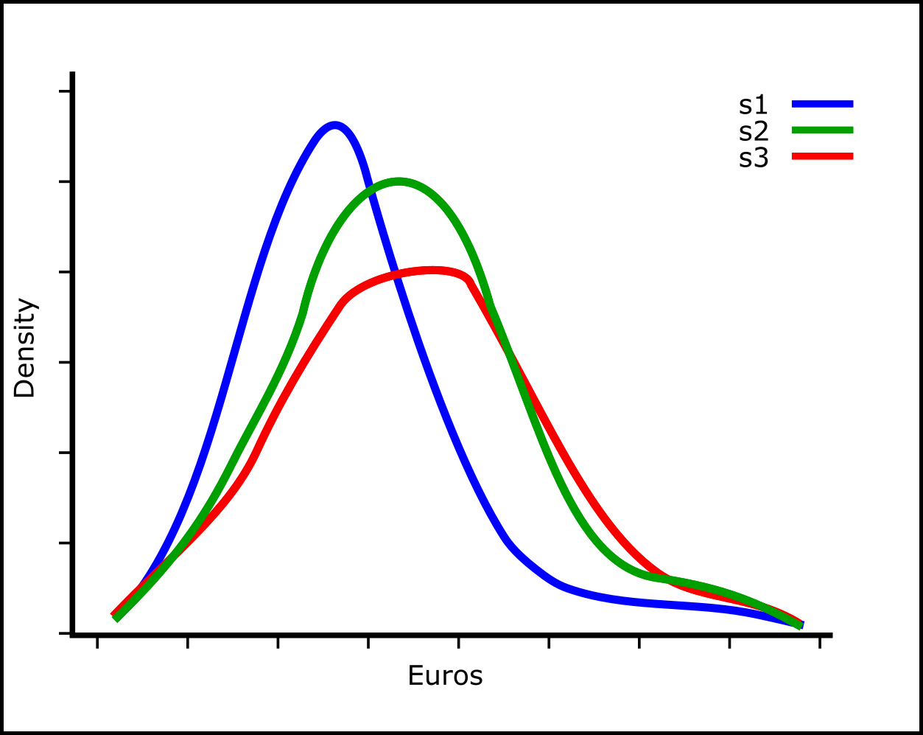
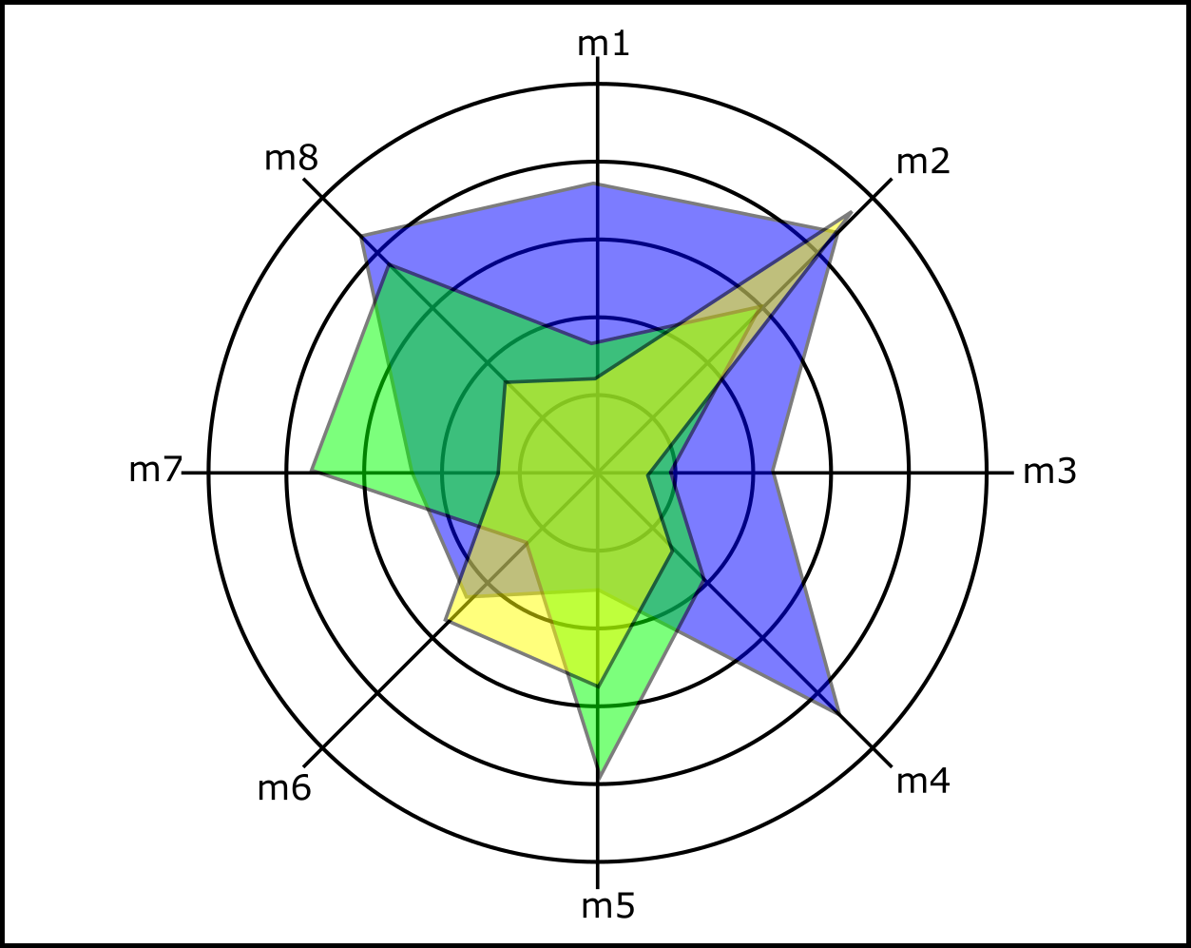
Studying the output: how to recognise a trade-off?
Deterministic trade-off: dependence of distribution over deterministic parameter

Slide 22
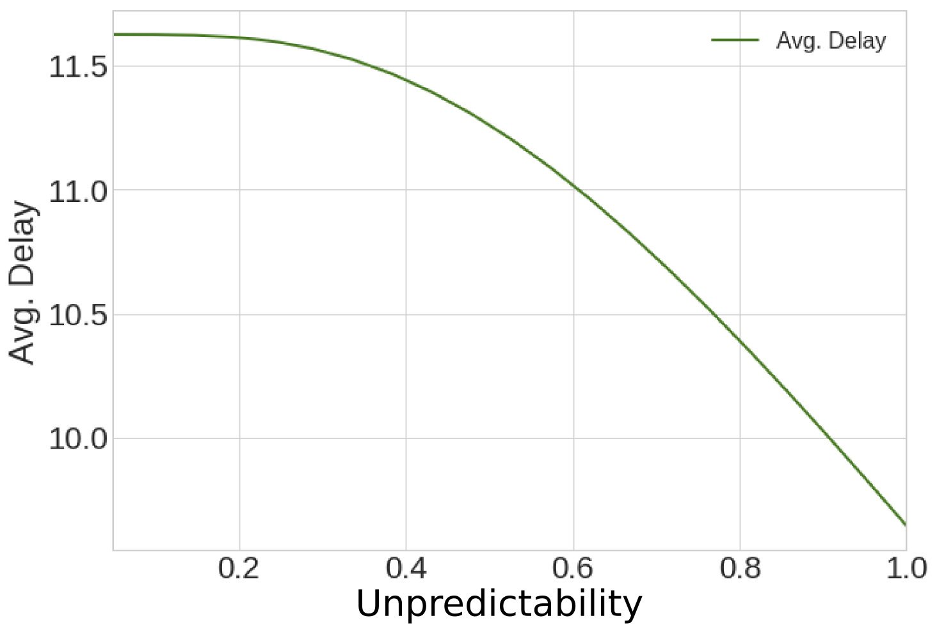
Trade-off example: predictabilty vs punctuality
One airport, unpredictability on departure delay is change artificially

Slide 23
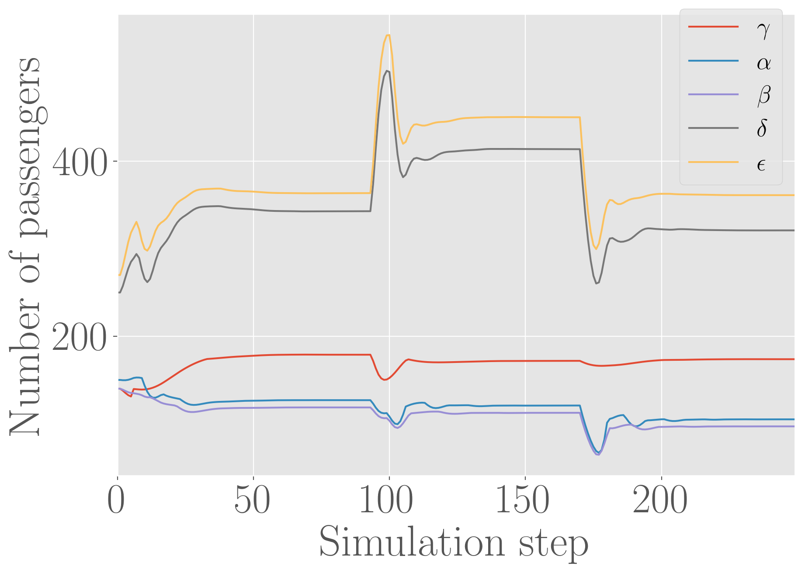
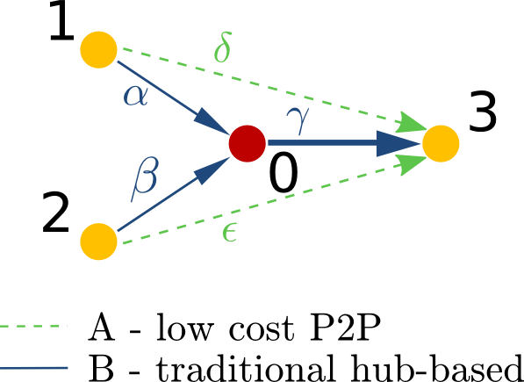
Trade-off example: LLC vs trad
Simplified setup: four airports, two airlines LLC/trad, capacity increase of airport 3

Slide 24
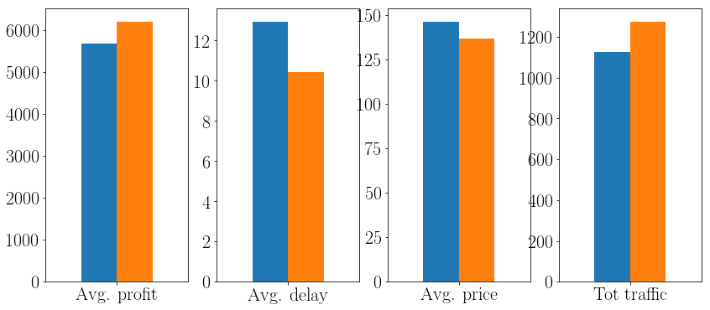
Trade-off example: LLC vs trad
In average, everyone is better after the capacity increase

Slide 25
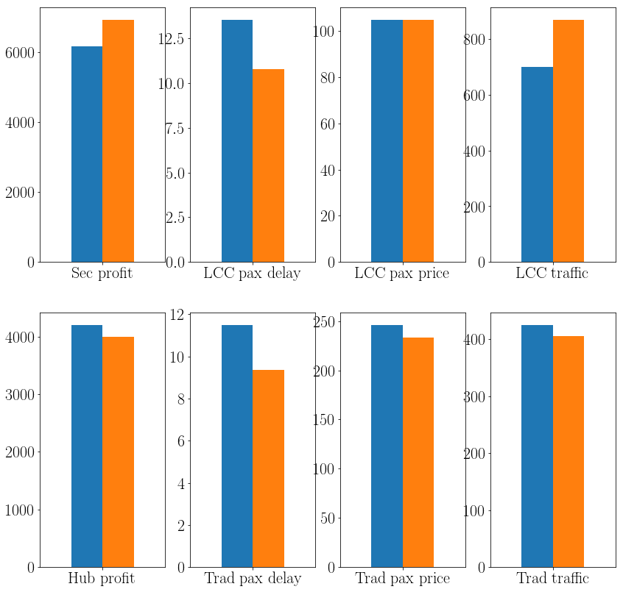
Trade-off example: LLC vs trad
But some agents are actually losing from the capacity increase!

Slide 26
Conclusions
Vista aims at understanding the trade-offs (or synergies) between KPIs in the future air transportation world – 2035 and 2050.
Requires to forecast the values of the KPIs, but also their relationships:
  Either by pure machine learning.
  Or by injecting other phenomenological laws into the model.
Vista is based on a multilayered architecture requiring very diverse types of data as input.
Additional, the different layers of the model need to communicate smoothly and reliably, thus requiring a central data repository.
Calibration (or training) is a main issue in this type of model and requires several steps involving data reduction and inner optimisation.
The trade-off analysis requires different techniques, including statistical regressions, but also careful data aggregation. Different tools can be used to help choose the best situation, including Pareto analysis etc.
Trade-offs can appear between different types of stakeholders, among different actors of the same type, among periods, etc.

Slide 27
Vista
Thank you

