Slide 1
System Wide Information Management
Dirk Janssens
SESAR SWIM Exploitation Project Manager
08 April 2015

Slide 2
Agenda
Situation today – the need for ATM Information sharing
SWIM ‘State of the Union’
Scope of SWIM
Benefits of SWIM
Building blocks
SWIM Outreach
Conclusion / next steps
Contact information

Slide 3










Situation Today
The right information / To right actor / At right time
Connecting
The
ATM
World
G/G & A/G

Slide 4

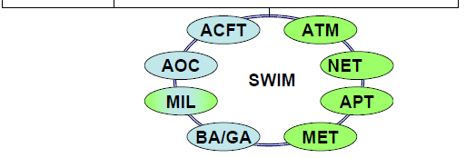

The need for sharing ATM information
Sharing Information
a Key enabler for
planning – executing - analysis
YEARS
6 MONTHS
DAYS
HOURS
MINUTES
ATM Planning
Phases
Business
Development
Planning
Execution
Forecasts
Airline Plans
Schedule Dev
Military Exercises
Major Events
Airspace Design
Negotiation on:
Schedules
Airspace
Routes
Resources
Plan refinement:
Arrival capacity
Departure planning
Weather
Local capacity mgt.
Traffic balancing
Real time synchronisation
Tactical De-Confliction
Tactical
Actions
Flight Object

Slide 5
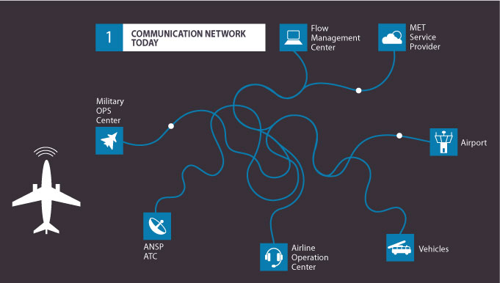
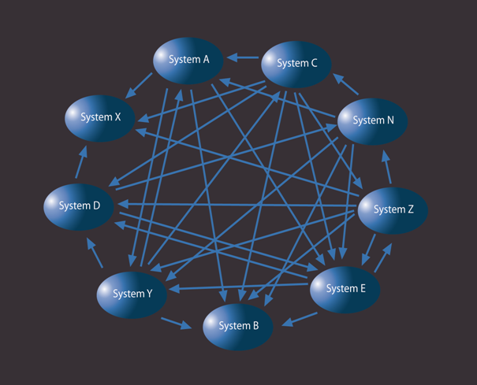
Today’s Information System …
Point to point connections
Partial visions
Duplications (… and gaps)
Multiple dedicated interfaces
Multiple specific technical solutions
Potential high costs
Limited inter-operability
Limited flexibility

Slide 6

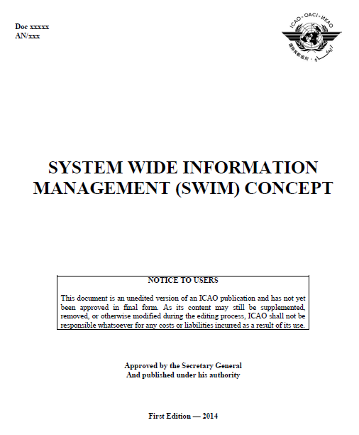

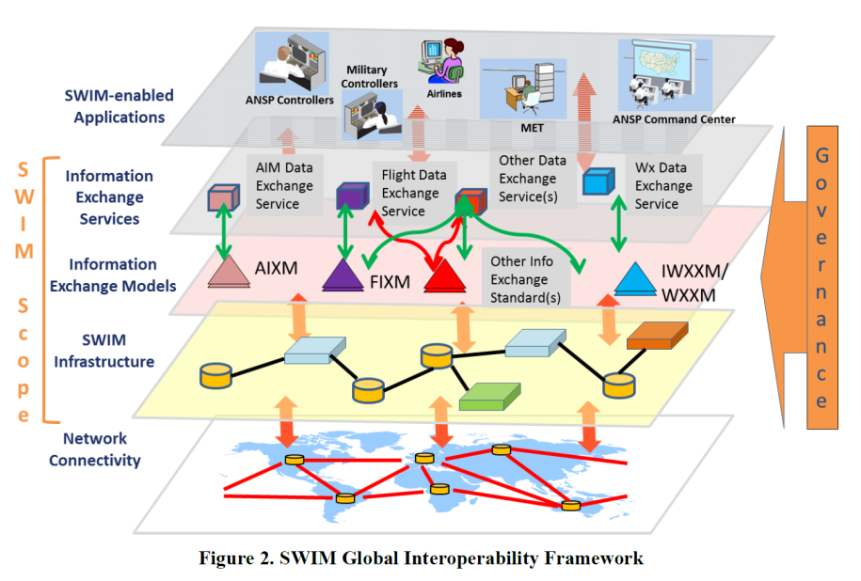

SWIM ‘State of the Union’
Definition : “SWIM consists of
standards, infrastructure & governance
enabling the management of ATM information
and its exchange between qualified parties
via interoperable services.”

Slide 7
SWIM Enablers and Benefits
SWIM will enable technical improvements like cheaper design, early (or easier) adoption, etc. These technical improvements will in their turn enable operational improvements like better situational awareness.
The operational improvements will contribute to the ATM Key Performance Areas (KPA) identified in the SESAR Programme.
SWIM enables better financial performance and unlocks new opportunities.
By using mainstream technologies, open formats and standardised interfaces, it is expected to reduce the costs associated with the development and deployment of new applications and services.
The service standardisation will facilitate the reuse of information in other contexts thereby contributing to cost efficiency.
The increased interoperability of data formats and interfaces will make possible a LEGO­-like system architecture, in which ATM systems from different manufacturers can be seamlessly connected, eliminating the need for expensive tailor-made interfaces.
A service approach

Slide 8

SWIM scope
(SWIM Enabled) Applications
Information
Governance R&R, Copyright, IPR, Charging, Liability
Data / Service models
Common methodology
Technology & Systems
Techno agnostic
SWIM Scope
Infrastructure
Messaging, Security, Recording, Supervision, Availability, ..
Maximum use of COTS
Content agnostic.
CNS Infrastructure
IP based network (PENS, internet)

Slide 9

Information
AIXM
  ICAO & Increasing implementations
  Digital NOTAM
  Lessons learned
WXXM
I(CAO)WXXM
  Reality mapping
  Data coming (really)
AIRM
Usage starting.
FIXM
  V3 / CCB
  Towards implementation – V4
What about me ?
AIDX, AMDB, Asterix, Inspire, ED133 …

Slide 10




Services
More and more services being Developed & Deployed
Towards a true business transformation !
Need for more Practical Global Coordination
(Service Harmonisation, Registry Discovery, …).

Slide 11

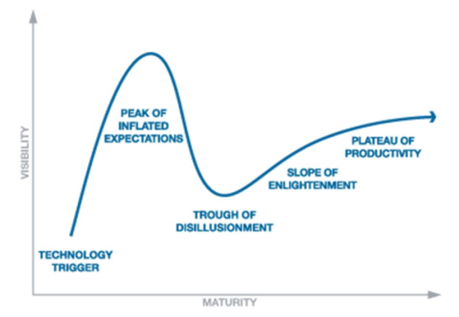


Technical Infrastructure
IT is found to be mature
Mostly an issue of agreeing on used (open) standards
Through so called Technical Profiles (Yellow / Blue / …)
E.g. Yellow = SOAP1.1/1.2, WSDL1.1/2.0, WSI1.2/2.0, WS-Security1.1, SSLv3/TLS1.0/1.1/1.2,
PKI x.509v3, XML-Encryption, XML-Signature, ECRYPT II, XML 1.0/1.1, XML-Schema,
WFS/WMS/…, HTTP/1.1, HTTP-GET/POST, MTOM, … (Red is core, rest is optional for Provider)
IT in ATM
Pub/Sub : AMQP1.0

Slide 12






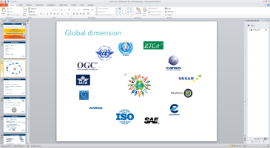
Governance
SWIM Compliance
  Supported by automated tools. E.g. AIXM Business Rules validator
Increased focus on security
ICAO Global Interoperability Framework (ICAO GIF).
Legacy
New SWIM Services
 | Ready | Compatible | Compliant
AIRM | Entities | +Properties & Relations | + Constraints
Services | Increased Service Description mapping
Techno | Partial Profile | Full Profile

Slide 13
SESAR SWIM Outreach
  Increase awareness
  Accellerate the practical uptake
Innovative R&D
Applied R&D
Industrialisation
Deployment
SWIM Demos
SWIM Master classes
SWIM Jumpstart
iSWIM
deployment
SESAR Demonstrations
SESAR Work Programme
More information
  www.sesarju.eu/swim
  www.sesarju.eu/masterclass
  www.swim.aero
  Mail to : swim@eurocontrol.int

Slide 14
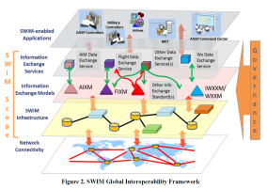
Conclusions
SWIM is a reality with impressive Benefits
AIRM/XMs/… : Foundation of it all
ICAO IM Panel ++
Services :
Need for more cooperation
More global trials / demos, Master Classes will further de-mistify and obtain more benefits : join us !!!

Slide 15

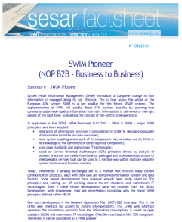
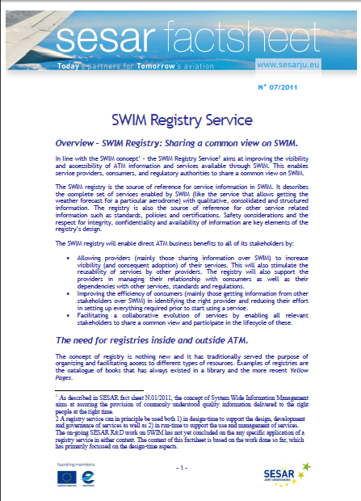
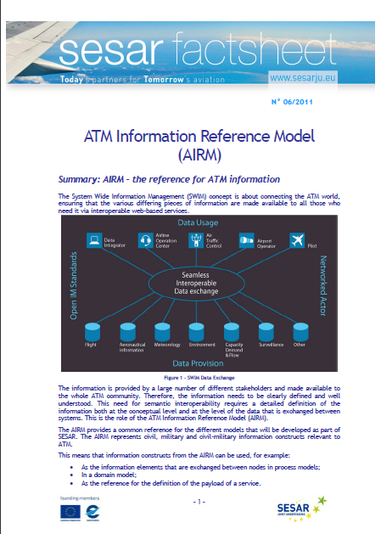
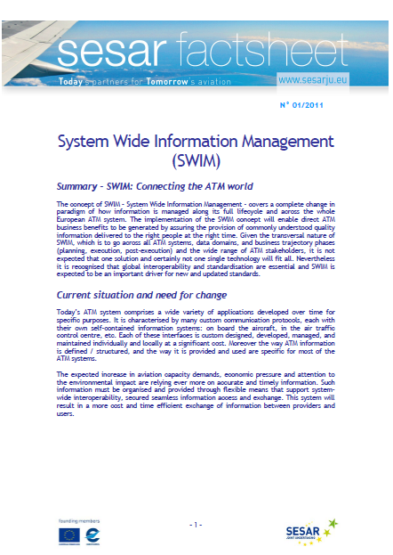
Contact Information
SESAR Joint Undertaking
www.sesarju.eu/swim
http://www.linkedin.com/groups?gid=3748809&trk=hb_side_g
Email swim@sesarju.eu
Data Exchange models
  Aviation Information Data Exchange www.aidx.aero
  AIXM - Aeronautical Information Exchange Model www.aixm.aero
  WXXM – Weather Information Exchange Model www.wxxm.aero
  FIXM - Flight Information Exchange Model www.fixm.aero
AIRM http://im.eurocontrol.int/wiki/index.php/AIRM
Some additional info
www.eurocontrol.int/im & im.eurocontrol.int/wiki
IM Panel http://www.icao.int/airnavigation/IMP/Pages/default.aspx
The Information Management Panel (IMP) was established to develop a global and harmonized interoperable approach and elaborate on necessary concepts in order to ensure effective management of information, including identifying the need for new information exchange on a system-wide basis within the air navigation system

