Slide 1

BALANCE OF HALA! AND PROPOSAL FOR FUTURE NETWORKS UNDER SESAR 2020
Francisco Javier Sáez Nieto
April, 2015

Slide 2
CONTENT:
Contribution of HALA! network to the ATM Community and SESAR,
General and overall balance of participating in networks for ATM,
Lessons learnt and what to improve,
Best practices,
How to face and organise networks under SESAR 2020.

Slide 3
Contribution of HALA! network to the ATM Community and SESAR:
Provide the framework to carry out research in Automation with a major focus on ATM;
Provide a highly specialized and fruitful venue for dissemination and discussion of advances performed by R&D organizations in the field of automation;
Stimulate exploratory research, creativity and innovation in ATM system (SESAR and beyond) grounding the results in knowledge from other domains involving automation;
Organize work activities for providing solutions (exploiting knowledge and results from the scientific research community) to the objectives of SESAR in areas such as aircraft trajectory management and cohesion, human factors, improved performances within the ATM or safety among others;
Encouraged participation of young scientists and young researchers in the field of R&D applied to ATM to provide new approaches.
Create and support a lively scientific community around the particular area of automation which was previously scattered in various disciplines;
Providing a repository of undergoing research in these domains fostering research activities in underrepresented areas and preventing duplication of efforts in popular ones.

Slide 4
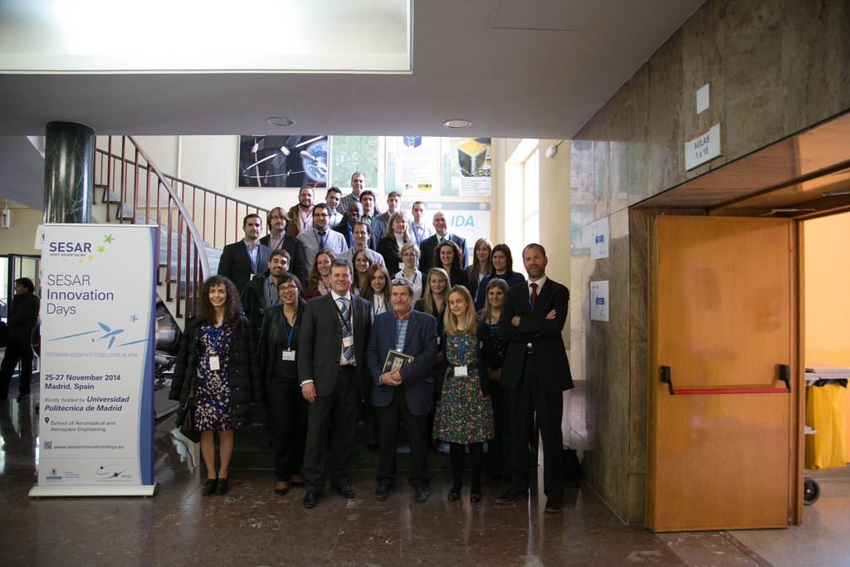
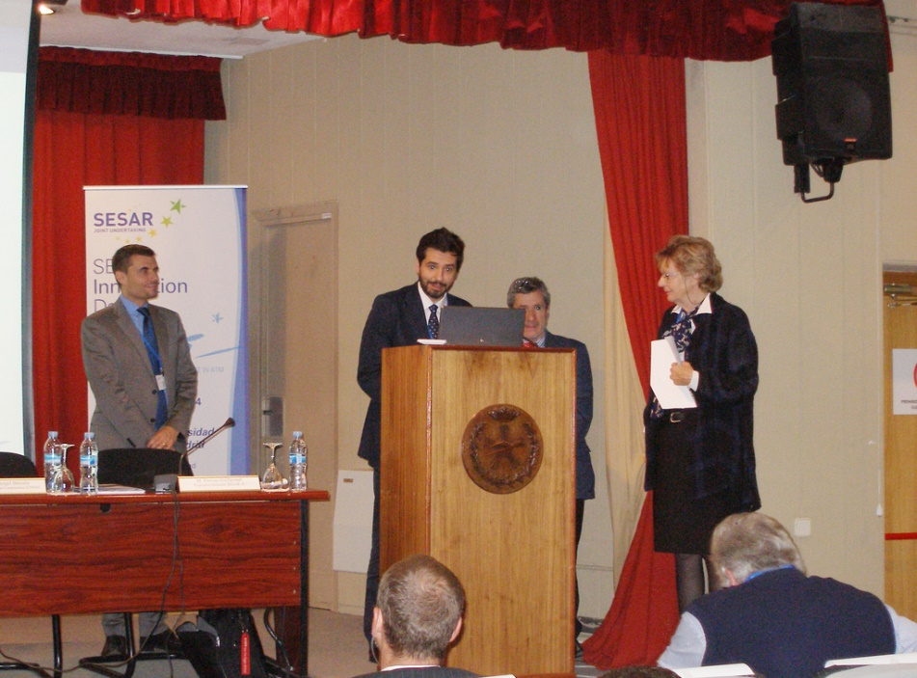
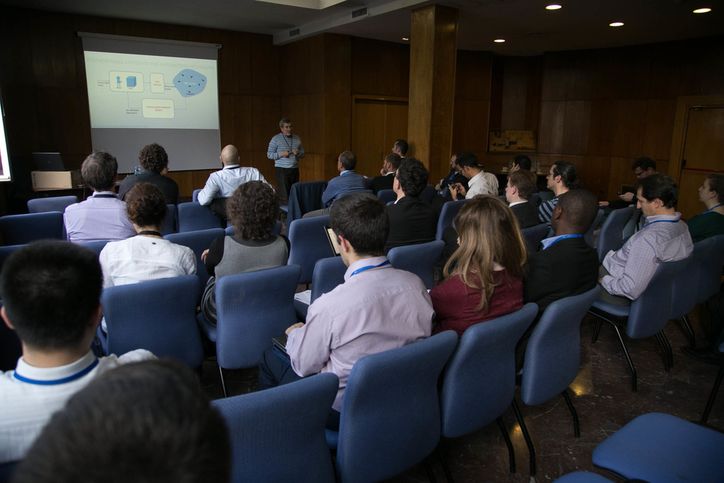
General and overall balance of participating in networks for ATM,
Has been an instrument to meet key players in the field and to stay in the leading edge of research in the area of the network.
Networking activities and to learn from theoretical contributions, advances and findings regarding the future ATM system
Participation allows members to “stay in the loop” and stay tuned with the state of the art in their areas or interest and in related scientific disciplines.

Slide 5

General and overall balance of participating in networks for ATM (Cont.), Position Paper.
Provide a unique open platform to express the views and reveal the knowledge existing within the research community
This is achieved by the elaboration and development of the so call “Position Paper” through which their members provide new and innovative ideas about the future ATM operational architecture and about the role that automation should play.
Position Paper

Slide 6
Lessons learnt and what to improve,
  Internal organization and participants:
    The management work has exceeded initial expectations, implying effort than expected at the expense of research and dissemination activities.
    The coordination of a large number of members, the limited resources and the required administrative paperwork have been the cause for management burden.
    Both, the administrative mechanisms and the number of the core members should be reduced.
    Maximize the number of participants, knowledge or academic initiatives is essential
    Members/participants should really be engaged in the network activities.
  External organization:
    Dissemination are key in networks’ activities to ensure the impact of the research work produced. This concerns both the research communities and the ATM Community.
    Promotion of joint activities with other disciplines (social sciences, computer sciences, etc..) and other industries (ground transportation, games and entertainment, nuclear, space, …).
    Some targeted support from SJU and/or EUROCONTROL could be helpful advertising the networks activities.

Slide 7



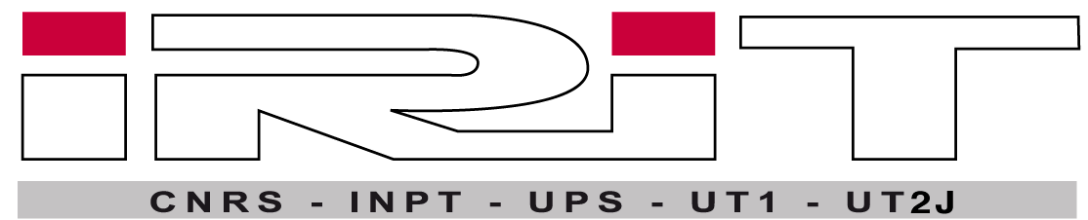
Best practices (1)
Activities performed under the networks (e.g HALA! Research Network) have proved to provide a highly revenue to the members and have been an excellent framework to disseminate knowledge and findings in the field.
ATACCS Conference: has provided a highly specialized forum to discuss the findings and advances achieved in automation within ATM. Having the proceedings of the conference available in the ACM digital library (http://dl.acm.org/citation.cfm?id=2494493) guarantees worldwide access to the research communities.
ATACCS'2015
5th International Conference on Application and Theory of Automation in Command and Control Systems

Slide 8
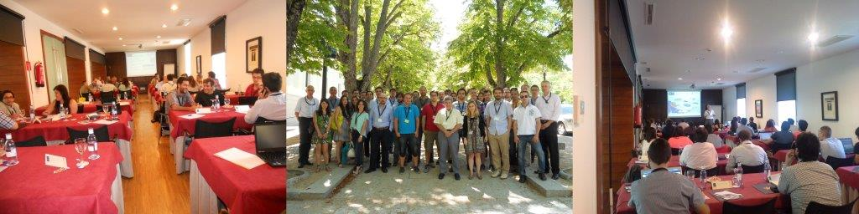

Best practices (2)
HALA! SUMMER SCHOOL:
AIR TRAFFIC SYSTEMS BASED ON 4D TRAJECTORY MANAGEMENT

Slide 9
Best practices (3): Funded PHD Thesis
A multi-model S based approach for the analysis and modelling of usable and resilient partly autonomous interactive systems
Exploiting Innovation Sensor Data Fusion Strategies for Sense and Avoid Units to be installed onboard Unmanned Aerial Systems
Trajectory management, including trajectory optimization, demand/capacity balancing, traffic synchronization safety barriers, detect and avoid systems, autonomy of flight/vs, centralised services provision, latency effects on all kind of agents remotely controlled are, among others, key research issues, that involves especially RPAS.
Application of the Theory of FL to the Modelling of Trajectory Uncertainty and the Analysis of its Impact in Future Trajectory-Based Operations
AUTOFLY‐Aid: Flight Deck Automation Support with Dynamic 4D Trajectory Management for Responsive and Adaptive Airborne Collision Avoidance
Uncertainty reduction by an ATS inherent aircraft state vector modelling and estimation
Stochastic Optimal Control towards Enhanced Predictability of four-dimensional Trajectories using of Weather Ensemble Prediction Forecasts
Supporting function allocation in human‐automation by means of dynamic performance measurement
Context-Aware Adaptive Automation in ATC
Aircraft Trajectory hierarchal, spatial and temporal cohesion among the different ATM agents, considered as part of a socio-technical multi-agent system, as key element for an efficient integrated ATM
Aircraft Turnaround Management in a highly automated 4D flight operations environment
Information Automation on the Flight Deck in the Context of 4D Trajectory based Operations
Development of an autonomous knowledge-based system state evaluation for an enhanced decision making process
Robust data fusion for 4D conflict-free optimal trajectories in a highly automated ATM system
User interface design for highly automated systems

Slide 10

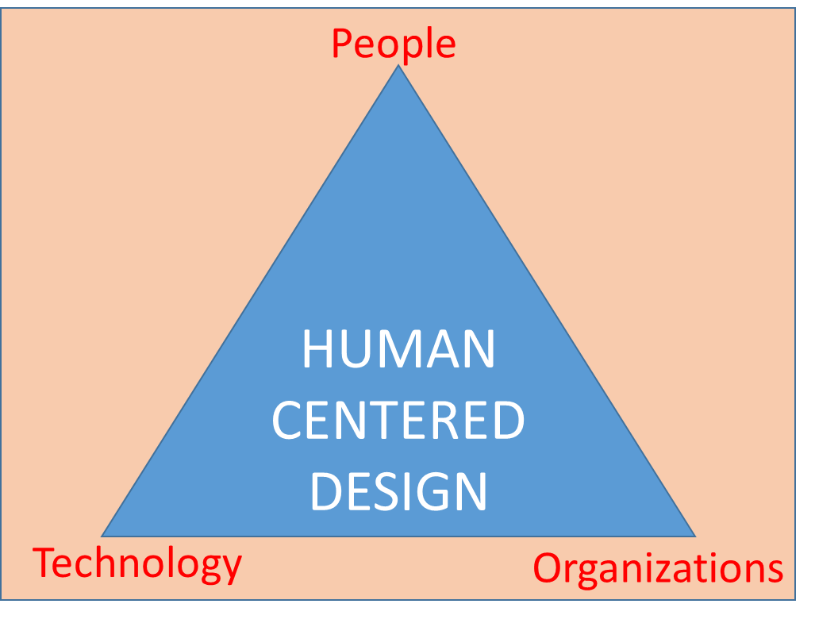
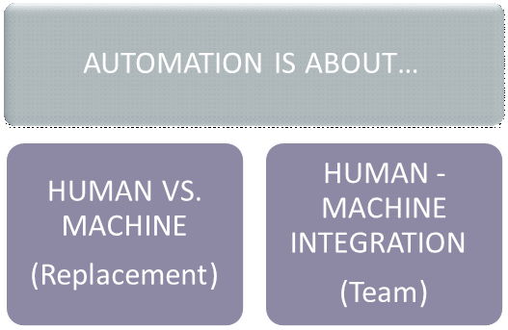
Best practices (4): Position Paper
ATM
Automation
Improvement of Processes through the use of Technology
Flight Trajectories Management

Slide 11
How to face and organise networks under SESAR 2020
Role | Benefits
Core member | Knowledge of and participation to the definition of the future ATM research strategy and agenda Networking opportunities Collaboration with qualified top level potential partners Contribution and participation to dedicated Workshops Contribution and participation to qualified Conferences Training opportunities for young researchers (such as summer schools) PhD for young researchers Economic revenues resulting from some of the activities above (indirect) Direct economic compensation for the work
Participant | Networking opportunities Contribution and participation to dedicated Workshops Contribution and participation to qualified Conferences Reading material about the research state of the art, open issues, etc. Training opportunities for young researchers (such as summer schools) PhD for young researchers Participation in publications related to specific topics from the network
User | Contribution and participation to qualified Conferences Reading material about the research state of the art, open issues, etc. Training opportunities for young researchers (such as summer schools)

Slide 12
Questions?

